Slide 1

1
Binary Trees
Notes:
Production Notes: Cheryl will be off screen and will speak to introduce the lesson.
Cheryl Notes:
“Welcome. This video introduces Binary Trees”

Slide 2

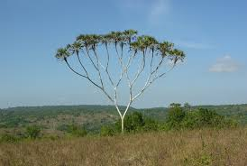
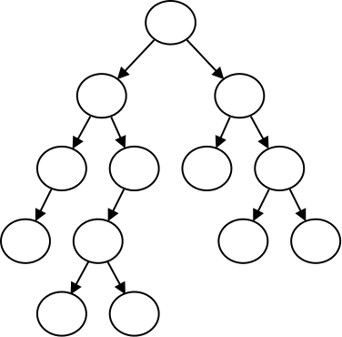
2
Trees
Notes:
Production Notes: Cheryl on screen.
Cheryl Notes:
All previous data organizations we've studied are linear—each element can have only one predecessor and successor
Accessing all elements in a linear sequence is O(n)
Trees are nonlinear and hierarchical
Tree nodes can have multiple successors (but only one predecessor)
This module focuses on the binary tree
In a binary tree each element has two successors
Binary trees can be represented by arrays and by linked data structures
Searching a binary search tree, an ordered tree, is generally more efficient than searching an ordered list—O(log n) versus O(n)

Slide 3
Tree Terminology
The node at the top of a tree is called its root
The successors of a node are called its children
dog
A node that has no children is called a leaf node
The predecessor of a node is called its parent
cow
wolf
cat
A subtree of a node is a tree whose root is a child of that node
Notes:
Production Notes: Off screen.
Cheryl Notes:
A tree consists of a collection of elements or nodes, with each node linked to its successors
CLICK
The node at the top is called the root
CLICK
Successors of a node are called its children
CLICK
The predecessor of a node is called its parent.
Each node in a tree has one parent, except for the root node, which has no parent.
A node that has no children is called a leaf node
Leaf nodes also are known as external nodes, and nonleaf nodes are known as internal nodes
A subtree of a node is a tree whose root is a child of that node.

Slide 4
Tree Terminology
Level 0
dog
The height of this tree is 2
Level 1
cow
wolf
Level 2
cat
Notes:
Production Notes: Off screen
Cheryl Notes:
The level of a node is its distance from the root
CLICK
If node n is the root of tree T, its level is 0
If node n is not the root of tree T, its level is 1 + the level of its parent
CLICK
The height of a tree is the number of nodes in the longest path from the root node to a leaf node

Slide 5
Full Binary Tree
7
1
1
0
3
0
3
2
5
4
6
Notes:
Production Notes: On screen
Cheryl Notes:
A full binary tree is a binary tree where all nodes have either 2 children or 0 children (the leaf nodes)

Slide 6
Perfect Binary Tree
3
1
5
0
2
4
6
Notes:
Production Notes: On screen.
Cheryl Notes:
A perfect binary tree is a full binary tree of height h with exactly 2^{h} – 1 nodes
In this case, h = 3 and 2^{h} – 1 = 7
In a perfect tree with n nodes, the height of the tree is O(log n)

Slide 7
Complete Binary Tree
3
1
5
0
2
4
Notes:
Production Notes: On screen.
Cheryl Notes:
A complete binary tree is a perfect binary tree through level n - 1 with some extra leaf nodes at level n (the tree height), all toward the left
The height of a complete tree is also O(log n)

Slide 8
Reference Based Tree Implementation
template <typename T>
class binaryTree
{
private:
struct binaryNode
{
T data;
binaryNode *left;
binaryNode *right;
}
binaryNode *root;
….
}

Slide 9
Reference Based Tree Implementation
template <typename T>
class binaryTree
{
private:
struct binaryNode
{
T data;
binaryNode *left;
binaryNode *right;
}
binaryNode *root;
….
}
binaryTree
binaryNode
root =
data = 3
left =
right =
3
binaryNode
binaryNode
1
5
data = 1
left = null
right = null
data = 5
left = null
right = null

Slide 10
Array Based Tree Implementation
template <typename T>
class binaryTree
{
T treeArray[MAX_SIZE];
….
}
3
1
5
0
2
4
treeArray
only practical for complete trees
3 1 5 0 2 4

Slide 11
2
Tree Traversals
7
1
10
0
3
9
12
2
5
11
13
4
6
Notes:
Production Notes: Cheryl on screen.
Cheryl Notes:
Often we want to determine the nodes of a tree and their relationship
We can do this by walking through the tree in a prescribed order and visiting the nodes as they are encountered
This process is called tree traversal
Three common kinds of tree traversal
Inorder
Preorder
Postorder

Slide 12
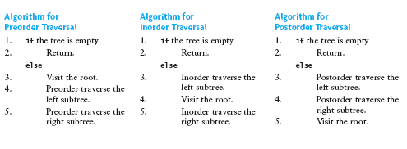
2
Tree Traversals
7
1
10
0
3
9
12
2
5
11
13
4
6
Notes:
Production Notes: Cheryl of screen.
Cheryl Notes:
Preorder: visit root node, traverse T_{L}, traverse T_{R} (demonstrate with drawing)
Inorder: traverse T_{L}, visit root node, traverse T_{R} (demonstrate with drawing)
Postorder: traverse T_{L}, traverse T_{R}, visit root node (demonstrate with drawing)

Slide 13
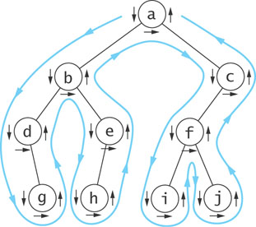
Tree Traversals – Euler Tour
Notes:
Production Notes: Cheryl on screen
Cheryl Notes:
You can visualize a tree traversal by imagining a mouse that walks along the edge of the tree
If the mouse always keeps the tree to the left, it will trace a route known as the Euler tour
The Euler tour is the path traced in blue in the figure
If you trace the order of visiting nodes before traversing the left sub tree (shown by down arrows), you get a pre order traversal
(Draw on slide to demonstrate)
a b d g e h c f i j
If you trace the order of returns from traversing its left subtree (shown by horizontal arrows in the figure) we get an inorder traversal
(Draw on slide to demonstrate)
d g b h e a i f j c
If you trace the order of nodes as we last encounters them, we get a postorder traversal (shown by the upward pointing arrows)
(Draw on slide to demonstrate)
g d h e b i j f c a

Slide 14

20
Notes:
Production Notes: Off screen.

